Slide 1
ساعت طلایی و جادویی
نوذر نخعی
استاد پزشکی اجتماعی
دانشگاه علوم پزشکی کرمان
Notes:
We designed this template so that each member of the project team has a set of slides with its own theme. Members, here’s how you add a new slide to just your set:
Mark where you want to add the slide: Select an existing one in the Thumbnails pane, click the New Slide button, then choose a layout. The new slide gets the same theme as the other slides in your set.
Careful! Don’t annoy your fellow presenters by accidentally changing their themes. That can happen if you choose a different theme from the Design tab, which changes all of the slides in the presentation to that look.

Slide 3
The magical golden hour

Slide 6
Early coordination of infants five senses: Sight, hearing, touch, taste, and smell as well as movement. The oxytocin surge in the 1st h of birth makes mother to keep the infant close to her chest and also establishes chemical connection between the two. The mother is attracted to the infants smell.

Slide 7
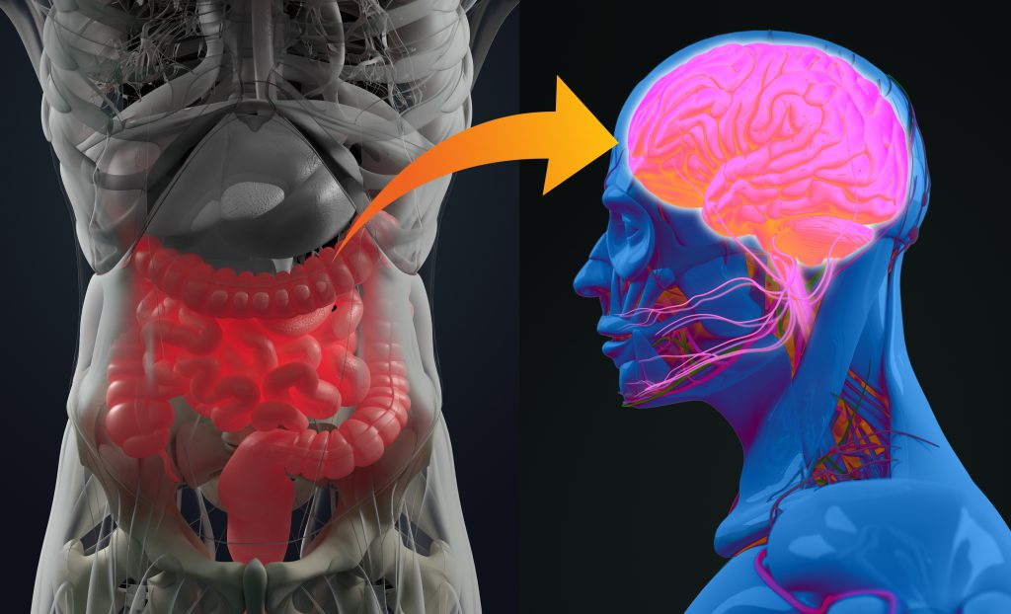
The skin-to-skin provides the initial colonization of the baby’s microbiome outside the mother
Skin-to-skin contact not only improves the bonding between mother and the infant but also influences infant’s self-regulation in the years to come

Slide 8
Mother’s constant and uninterrupted physical presence is necessary throughout early childhood and beyond
Separation of primate infants from their mothers could lead to disastrous effects on their following development and behaviour.
SSC can regulate the stress, anxiety, and psychological distress of both the mother and the infant, especially during COVID-19 Era.

Slide 9
The effects of mother-infant SSC on exclusive breastfeeding was statistically significant [odds raito (OR)=2.2; 95% confidence interval (CI): (1.66-2); p<0.001].

Slide 10
خشت اول چون نهد معمار کج
تا ثریا می رود دیوار کج!!

